Slide 1
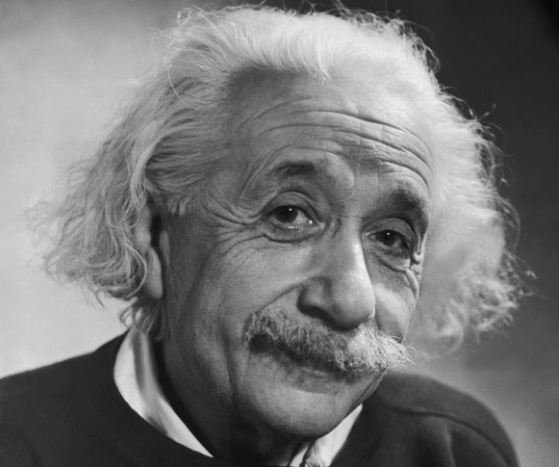
“I fear the day that technology
will surpass our human
interaction. The world will
have a generation of idiots. ”
Albert Einstein

Slide 3
THE EVOLUTION OF SOCIAL MEDIA MESSAGING
2010-
?????

Slide 4
ACTIVITY 1

Slide 5
ACTIVITY 1

Slide 6
ACTIVITY 2

Slide 7
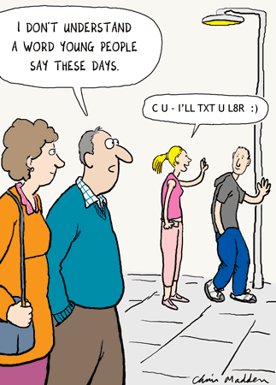
ACTIVITY 2 GROUP 1 REFLECTION

Slide 8
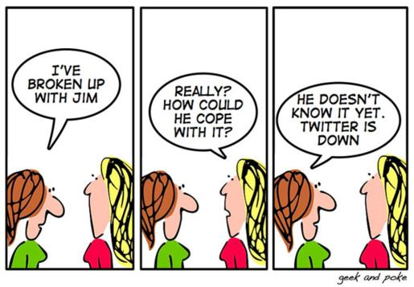
ACTIVITY 2 GROUP 2 REFLECTION

Slide 9
ACTIVITY 2 GROUP 3 REFLECTION

Slide 10
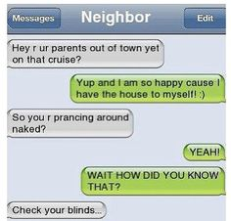
ACTIVITY 2 GROUP 4 REFLECTION

Slide 11
ACTIVITY 3

